Slide 1

Analysis of recent Measles outbreak
Data analysis

Slide 2
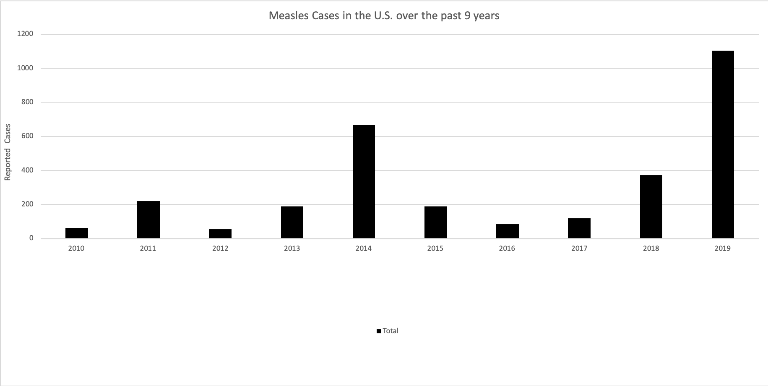
Recent MEASLES outbreak – first half of 2019

Slide 3
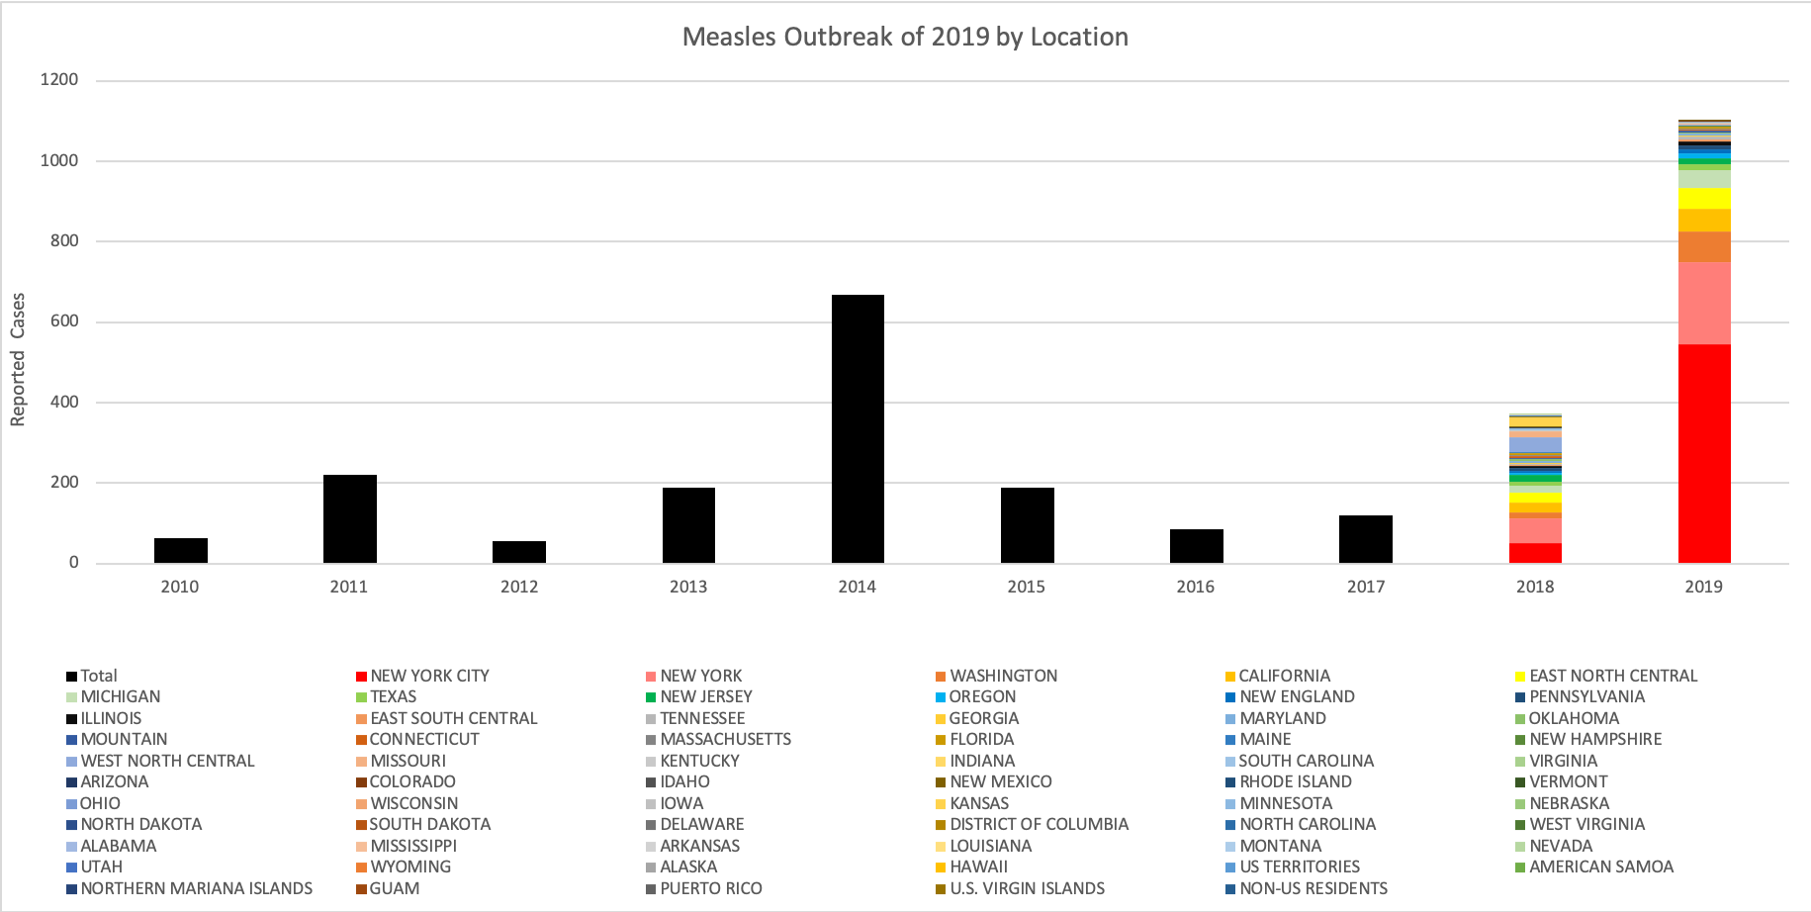
examining recent years by state

Slide 4
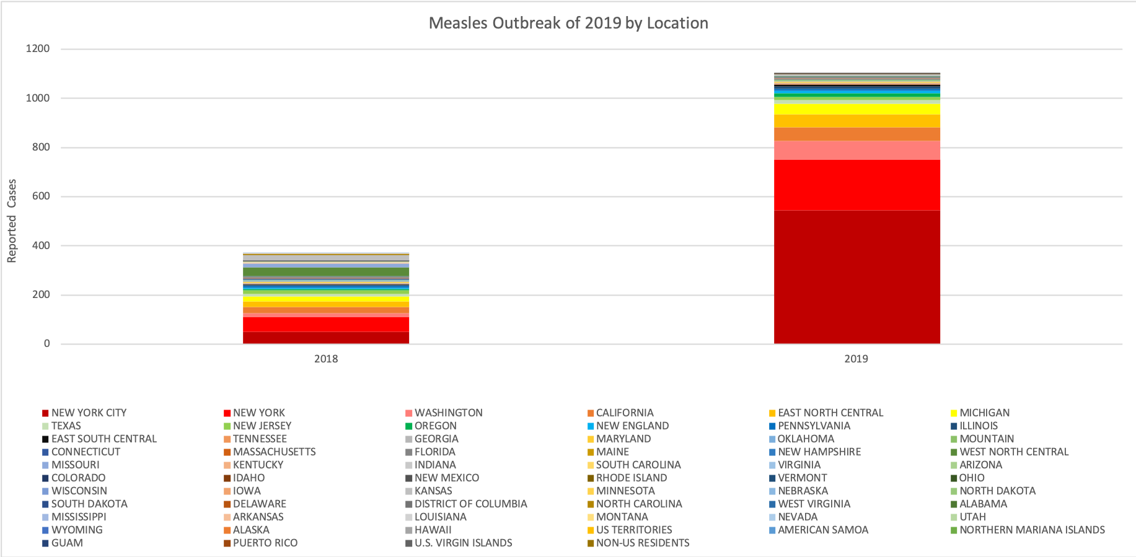
Identifying states with most reported cases in 2018 & 2019

Slide 5
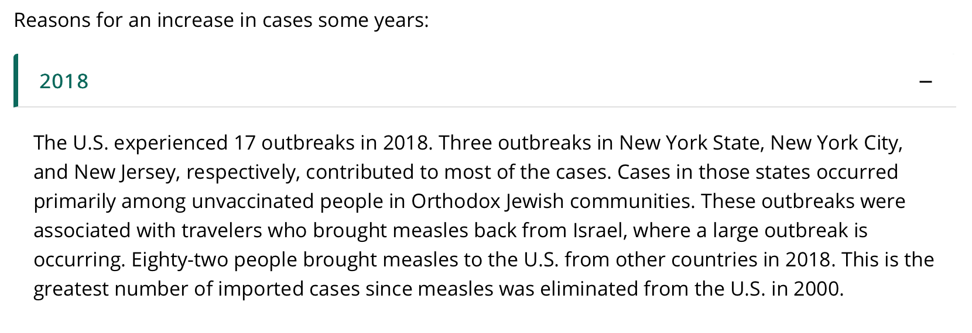
CDC has provided some explanation : 2018

Slide 6
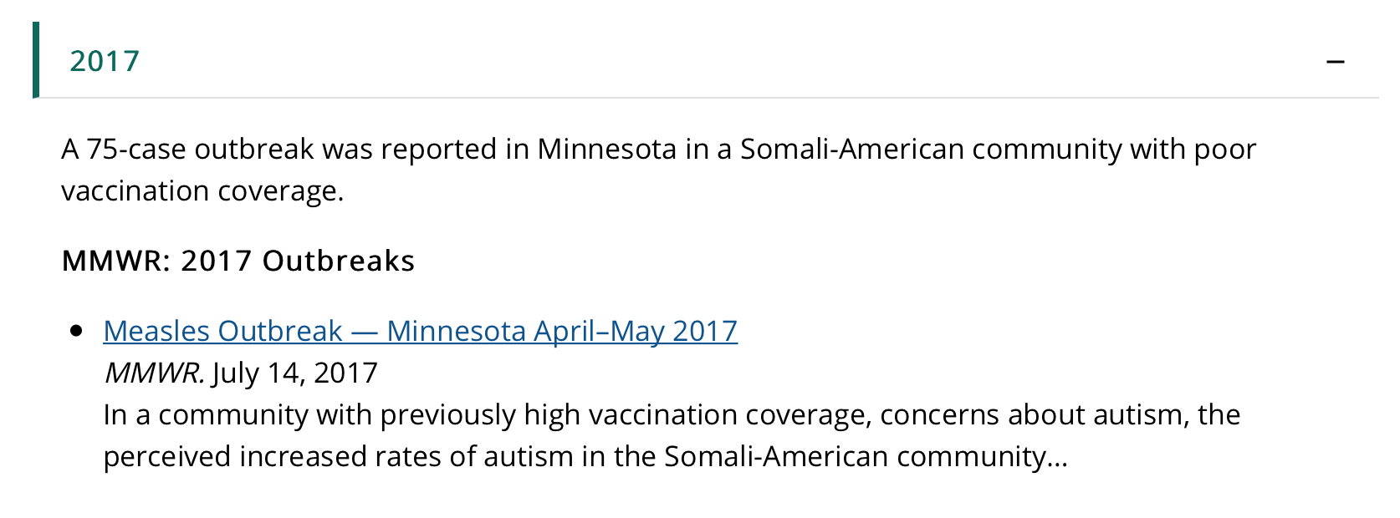
CDC has provided some explanation : 2017

Slide 7
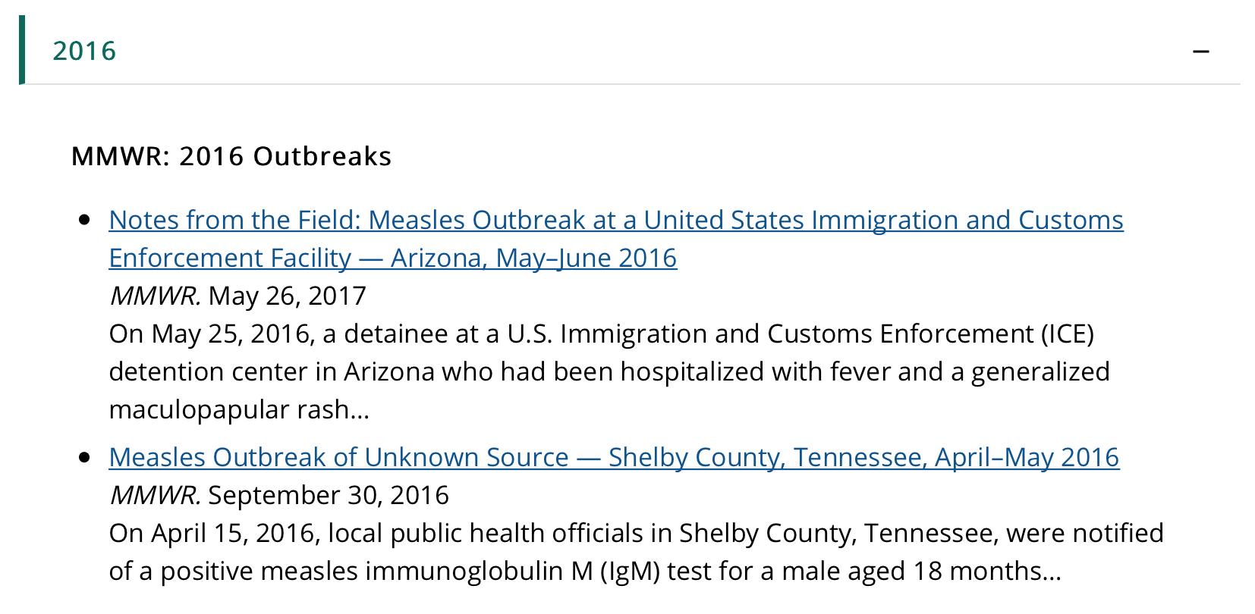
CDC has provided some explanation : 2016

Slide 8
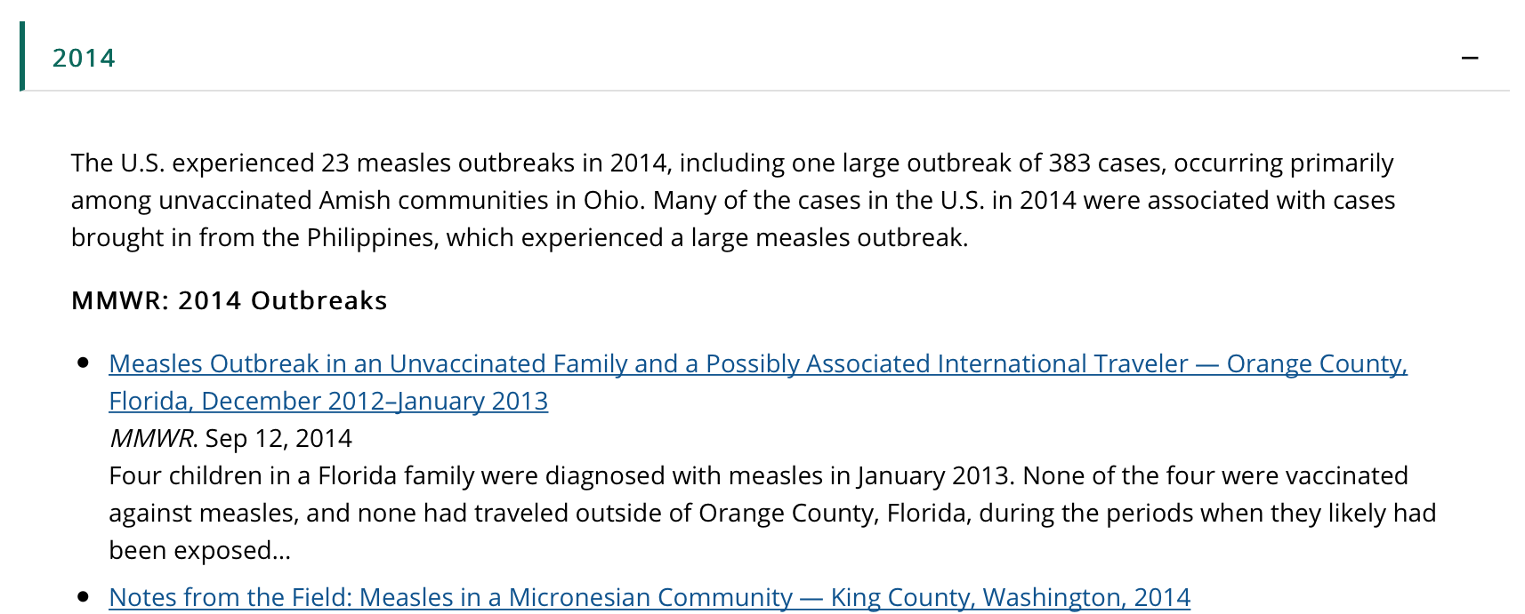
CDC has provided some explanation : 2014

Slide 9
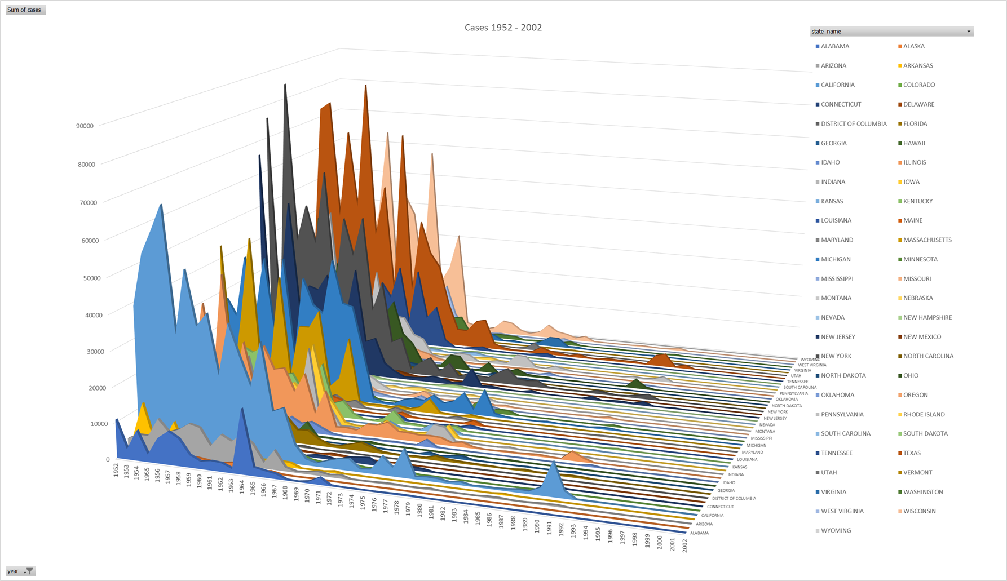
Whatever the reasons, levels are still higher than historical low levels

Slide 10
Will this outbreak be like the outbreak of early 1990’s? or will it last longer?

Slide 11
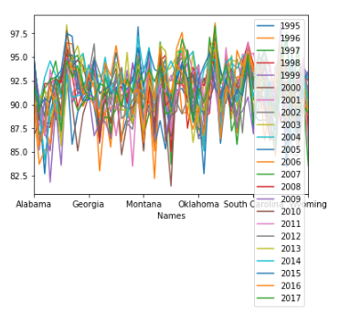
Has vaccination levels changed in the U.S.?

Slide 12
What has been the measles levels outside the U.S.?

